Slide 1
Internal presenter notes: What attendees should take away
Formatting Reminders:
15-20 slides maximum
Font: Segoe UI, 18pt minimum, 36pt maximum
Code Font: Consolas, 20pt minimum
Include complete speaker notes on every slide
Use the slide options and styles as desired
Remember that we’re building slides for mass public consumption, and any presenter should be able to use them
Presenters are welcome to personalize the presenter slide or make minor adjustments throughout the deck, as long as they convey the main concepts to attendees.

Slide 2
Internal presenter notes: What attendees should take away
Content Creators: Write 3 things an attendee should take away from the presentation.
This will help presenters home in on the main points.
Ingesting data with Apache Spark notebooks in Azure Synapse Analytics
Transforming data with DataFrames in Spark pools in Azure Synapse Analytics
Integrating SQL and Spark pools in Azure Synapse Analytics
Notes:
Welcome to slide deck 3 of 5 of the Azure Synapse Analytics Virtual Training Days
As well as delivering the three items in the slide above, we wanted to use this slide to take the opportunity to share our approach in the creation of this content
Virtual Training Day principles
Virtual Training Day's (VTD) are 5 x 45-minute demo-based sessions that inform the attendees about specific aspects of a technology. They are designed to address a scenario that the technology, or a component of the technology can solve. Due to the limited time, the intention is not to provide deep dive coverage of the content, but to show the art of the possible that will motivate the attendees to find out more information through other channels of learning such as MS Learn or Microsoft Official Curriculum.
Instructional Design principle's
As the intention of this content is to provide information on how a technology can work against a specific scenario in such a short space of time. The instructional design principle for the Azure Synapse Analytics Virtual Training day is to place most of the focus on letting the product shine through demo's. Therefore, the decision has been made that approximately 20 - 30% of the delivery is the slides in this deck, with 70% - 80% based on the demo.
How best to prepare this content
In order to be successful in delivering this content you must thoroughly prepare the following assets:
PowerPoint.
Every PowerPoint slide that has information to the delivery about the technology has presenter notes that outline the talking points for the slide, and also the presenter guidance on how the content could be delivered. That’s not to say that you have to follow the guidance as an experienced presenter, but it may give you some insight into why a slide has been designed in the way it has.
You should be very comfortable with the content in the slides and the notes section, and you should also extensively review the links that have been provided as background information.
Demo’s
You must commit the demo steps to muscle memory, and you should be able to perform the demo’s without looking at instructions to complete them in the time allocated. If you rely on performing a single run through the night before a delivery, your chances of success in the delivery of this content is low.
Azure Synapse Analytics is a very dense product with a broad range of capabilities. As the intention is to showcase the components of the technology to solve common scenarios or issues that customers face, the team performed extensive research with various stakeholders producing content that we hope will resonate with your audience.
The demo document not only provides the instructions on how to perform a technical step; with images, during the demo. There is also an extensive running commentary in the demo steps that explores why you would do something, or how it works. Sometimes you may find a technical instruction in the demo document may only be one line, but there may be a paragraph that follows that explains why that step was taken.
Demo setup
As Azure Synapse Analytics is a very dense product, the setup for the demos takes 3.5- 4 hours. The actual setup steps you take account for about 30 minutes of your time, but there is one setup script that takes approximately 3 hours to run. Not only does this script involve provisioning the services to support the demo, but also the data that will be used in the demo too. Why? As an example, the demo is deck one provide an introduction of the entire product with the demo running through of all the active component of Azure Synapse Analytics.
Roadmap information:
Note that some component of Azure Synapse Analytics is still in preview, so our roadmap includes the following changes and improvement in the future
To update the content as the product evolves
To look at ways of improving the setup process through a more targeted setup
Conversion of demo steps as exercises on the MS Learn platform.

Slide 3
Perform Data Engineering with Azure Synapse Spark pools
Speaker name
Notes:
TALKING POINTS
Let’s go over what Data Engineering means within Apache Spark pools in Azure Synapse Analytics
How many of you have used Apache Spark pools in Azure Synapse Analytics?
PRESENTER NOTES AND GUIDANCE
Poll your audience, ask them for examples on data engineering, get conversational on the topic, but don’t spend too much time.

Slide 4
Agenda
Understanding big data engineering with Apache Spark in Azure Synapse Analytics
Ingesting data with Apache Spark notebooks in Azure Synapse Analytics
Transforming data with DataFrames in Spark pools in Azure Synapse Analytics
Integrating SQL and Spark pools in Azure Synapse Analytics
Notes:
TALKING POINTS
Let’s set an agenda for today’s meeting in which we are going to discuss the following:
Understanding big data engineering with Spark in Azure Synapse
Ingesting data with Spark notebooks in Azure Synapse
Transforming data with DataFrames in Spark within Synapse
Integrate SQL and Spark pools in Azure Synapse Analytics
PRESENTER NOTES AND GUIDANCE
Don’t take too much time in order to present the agenda. Make the points in the topics.

Slide 5
Understanding big data engineering with Apache Spark in Azure Synapse Analytics
Notes:
TALKING POINTS
Let’s go over what Apache Spark pools are in Azure Synapse Analytics
How many of you have used Apache Spark pools in Azure Synapse Analytics, Azure Databricks, Apache Spark, HDInsight?
Talk about an example, like spending a lot of time to do a calculation with SQL in an ETL process
Usecase for Spark pools:
Data Engineering/Data Preparation
Apache Spark includes features to support preparation and processing of large volumes of data so that it can be made more valuable and then consumed by other services within Synapse Analytics.
Languages included:
- .Net Spark (C#)
- Spark (Scala)
- PySpark (Python)
- Spark (SQL)
PRESENTER NOTES AND GUIDANCE
Poll your audience, ask them for examples on data engineering and the products we have to support that, get conversational on the topic, but don’t spend too much time.

Slide 6
What to use when and where
 | Apache Spark | HDInsight | Azure Databricks | Synapse Spark
WHAT | Is an Open Source memory optimized system for managing big data workloads | Microsoft implementation of Open Source Spark managed within the realms of Azure | A managed Spark as a Service solution | Embedded Spark capability within Azure Synapse Analytics
WHEN | When you want to benefits of spark for big data processing and/or data science work without the Service Level Agreements of a provider | When you want to benefits of OSS spark with the Service Level Agreement of a provider | Provides end to end data engineering and data science solution and management platform | Enables organizations without existing Spark implementations to fire up a Spark cluster to meet data engineering needs without the overheads of the other Spark platforms listed
WHO | Open Source Professionals | Open Source Professionals wanting SLA's and Microsoft Data Platform experts | Data Engineers and Data Scientists working on big data projects every day | Data Engineers, Data Scientists, Data Platform experts and Data Analysts
WHY | To overcome the limitations of SMP systems imposed on big data workloads | To take advantage of the OSS Big Data Analytics platform with SLA's in place to ensure business continuity | It provides the ability to create and manage an end to end big data/data science project using one platform | It provides the ability to scale efficiently with spark clusters within a one stop shop DataWarehousing platform of Synapse.
Apache Spark
Azure Databricks
Great point
Did you know…
Wow, another great point!
OK, but did you know…
Notes:
Talking Points:
Apache spark is a open source memory optimized system for managing big data workloads, which is used when you want a spark engine for big data processing or data science where you don’t mind that there is no SLA provided. Usually this is of interest of Open Source Professionals and the reason for Apache spark is to overcome the limitations of what was known as SMP systems for big data workloads.
HDI is a implementation by Microsoft of Open Source Spark, managed on the Azure Platform. You can use HDI for a spark environment when you are aware of the benefits of Apache Spark in it’s OSS form, but you want a SLA. Usually this of interest of Open Source Professionals needing an SLA as well as Data Platform experts experienced with Microsoft.
Azure Databricks is a managed Spark as a Service propriety Solution that provides an end to end data engineering/data science platform as a solution. Azure Databricks is of interest for Data Engineers and Data Scientists, working on big data projects daily because it provides the whole platform in which you have the ability to create and manage the big data/data science pipelines/projects all on 1 platform.
Synapse Spark is a capability of Spark embedded in Azure Synapse Analytics in which organasiations that don’t have existing spark implementations yet, give the functionality to spin up a spark cluster to meet data engineering needs without the overhead of the other Spark Platforms listed. Data Engineers, Datascientist, Data Platform Experts and Data Analyst can come together within Synapse Analytics where the Spark cluster is spun up quickly to meet the needs. It provides scale in an efficient way for Spark Clusters and integrates with the one stop shop Datawarehousing platform of Synapse.
Instructor notes:
Apache Spark History:
Apache Spark has its architectural foundation in the resilient distributed dataset (RDD), a read-only multiset of data items distributed over a cluster of machines, that is maintained in a fault-tolerant way.^{[2]}
Spark and its RDDs were developed in 2012 in response to limitations in the MapReduce cluster computing paradigm, which forces a particular linear dataflow structure on distributed programs: MapReduce programs read input data from disk, map a function across the data, reduce the results of the map, and store reduction results on disk. Spark's RDDs function as a working set for distributed programs that offers a (deliberately) restricted form of distributed shared memory.^{[8]}
HDInsight General Info:
Azure HD Insight is a Hadoop service offering hosted in Azure that enables clusters of managed hadoop instances. Azure HDInsight deploys and provisions Apache Hadoop clusters in the cloud, providing a software framework designed to manage, analyze, and report on big data with high reliability and availability. Azure HD Insight uses the Hortonworks Data Platform (HDP) Hadoop distribution.
Databricks General Info:
Databricks grew out of the AMPLab project at University of California, Berkeley that was involved in making Apache Spark, an open-source distributed computing framework built atop Scala. Databricks develops a web-based platform for working with Spark, that provides automated cluster management and IPython-style notebooks.
Synapse Spark:
Azure Synapse Spark, known as Spark pools, is based on Apache Spark and provides tight integration with other Synapse services.
Traditional Spark developers now have Spark pools pre-loaded with Anaconda libraries offering over 200 libraries for machine learning, data analysis, visualization. It also comes with support for Delta Lake and integrations with AAD, Data Lake storage and others.

Slide 7
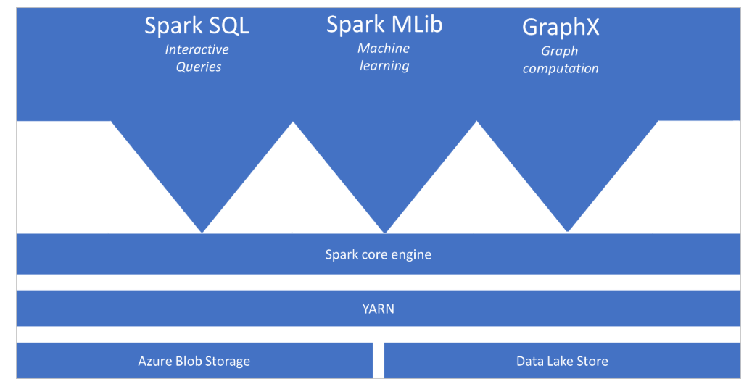
Apache Spark
Notes:
TALKING POINTS
What is Apache Spark:
Apache Spark is a parallel processing framework that supports in-memory processing to boost the performance of big-data analytic applications.
Apache Spark in Azure Synapse Analytics is one of Microsoft's implementations of Apache Spark in the cloud. Azure Synapse makes it easy to create and configure a Spark pool (preview) in Azure. Spark pools in Azure Synapse are compatible with Azure Storage and Azure Data Lake Generation 2 Storage. So you can use Azure Spark pools to process your data stored in Azure.
What are the benefits of Spark pools in Azure Synapse Analytics:
Speed and efficiency:
Spark instances start in approximately 2 minutes for fewer than 60 nodes and approximately 5 minutes for more than 60 nodes. The instance shuts down, by default, 5 minutes after the last job executed unless it is kept alive by a notebook connection.
Ease of creation and use including Pre-Loaded Anaconda libraries
You can create a new Spark pool in Azure Synapse in minutes using the Azure portal, Azure PowerShell, or the Synapse Analytics .NET SDK. See Get started with Spark pools in Synapse Analytics.
Synapse Analytics includes a custom notebook derived from Nteract. You can use these notebooks for interactive data processing and visualization.
REST APIsSpark in Synapse Analytics includes Apache Livy, a REST API-based Spark job server to remotely submit and monitor jobs.
Spark pools in Azure Synapse come with Anaconda libraries pre-installed. Anaconda provides close to 200 libraries for machine learning, data analysis, visualization, etc.
Support for Azure Data Lake Storage Gen2:
Spark pools in Azure Synapse can use Azure Data Lake Storage Gen2 as well as BLOB storage. For more information on Data Lake Storage, see Overview of Azure Data Lake Storage.
Scalability:
Apache Spark in Azure Synapse pools can have Auto-Scale enabled, so that pools scale by adding or removing nodes as needed.
Also, Spark pools can be shut down with no loss of data since all the data is stored in Azure Storage or Data Lake Storage.
What are the Apache Spark Concepts in Azure Synapse Analytics;
Spark pools:
A Spark pool (preview) is created in the Azure portal. It is the definition of a Spark pool that, when instantiated, is used to create a Spark instance that processes data. When a Spark pool is created, it exists only as metadata; no resources are consumed, running, or charged for. A Spark pool has a series of properties that control the characteristics of a Spark instance; these characteristics include but are not limited to name, size, scaling behavior, time to live.
As there is no dollar or resource cost associated with creating Spark pools, any number can be created with any number of different configurations. Permissions can also be applied to Spark pools allowing users only to have access to some and not others.
A best practice is to create smaller Spark pools that may be used for development and debugging and then larger ones for running production workloads.
You can read how to create a Spark pool and see all their properties here Get started with Spark pools in Synapse Analytics
Example:
- You create a Spark pool called SP1; it has a fixed cluster size of 20 nodes.
- You submit a notebook job, J1 that uses 10 nodes, a Spark instance, SI1 is created to process the job.
- You now submit another job, J2, that uses 10 nodes because there is still capacity in the pool and the instance, the J2, is processed by SI1.
- If J2 had asked for 11 nodes, there would not have been capacity in SP1 or SI1. In this case, if J2 comes from a notebook, then the job will be rejected; if J2 comes from a batch job, then it will be queued.
Spark Instances:
Spark instances are created when you connect to a Spark pool, create a session, and run a job. As multiple users may have access to a single Spark pool, a new Spark instance is created for each user that connects.
When you submit a second job, then if there is capacity in the pool, the existing Spark instance also has capacity then the existing instance will process the job; if not and there is capacity at the pool level, then a new Spark instance will be created.
Example:
You create a Spark pool call SP2; it has an autoscale enabled 10 – 20 nodes
You submit a notebook job, J1 that uses 10 nodes, a Spark instance, SI1, is created to process the job.
You now submit another job, J2, that uses 10 nodes, because there is still capacity in the pool the instance auto grows to 20 nodes and processes J2.
PRESENTER NOTES AND GUIDANCE
Please go over the concepts of Apache Spark as outlined

Slide 8
Ingesting data with Apache Spark notebooks in Azure Synapse Analytics
Notes:
TALKING POINTS
Let’s go over how to Ingest Data with Apache Spark Notebooks in Azure Synapse Analytics.
How many of you have used Apache Spark pools in Azure Synapse Analytics, Azure Databricks, Apache Spark, HDInsight?
Talk about an example, of notebooks within the platforms provided.
PRESENTER NOTES AND GUIDANCE
Poll your audience, ask them for examples on data engineering in which they have used a notebook and tried to load data and the products we have to support that, get conversational on the topic, but don’t spend too much time.

Slide 9
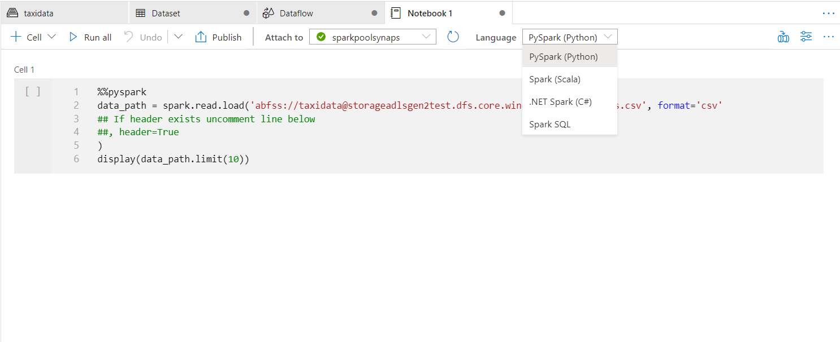
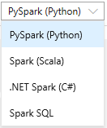

Develop Hub - Notebooks
Notebooks
Access through workspace URL: https://web.azuresynapse.net/
Examples Available through Knowledge Center
Allows to write multiple languages in one notebook by using %%<Name of language>
Support for Language Syntax highlight, syntax error, syntax code completion
Offers temporary tables across languages
Export results
Notes:
Talking Points
Through the develop hub in the synapse workspace you can create notebooks.
These notebooks can be written in with multiple languages like PySpark, Spark SQL etc.
In order to ingest data through notebooks you can use a linked service from the workspace, to for example an Azure Data Lake storage which then the keys and access is automatically passed through to the storage account where you have stored the file that you want to ingest or read out into a spark DataFrame.
You can access data in the primary storage account directly. There's no need to provide the secret keys. In Data Explorer in the Synapse Workspace, right-click on a file and select New notebook to see a new notebook with data extractor autogenerated.
See this link for more information:
https://docs.microsoft.com/en-us/azure/synapse-analytics/spark/apache-spark-development-using-notebooks
Creating own DataFrame:
It is also possible to create your own DataFrame within Azure Synapse Analytics running on a Spark Pool within the datahub of Synapse Workspaces with data created on your own without a source specifically.
You can load data from Azure Blob Storage, Azure Data Lake Store Gen 2, and SQL pool.
For example you can ingest Data into a Spark DataFrame by reading a CSV from an Azure Data Lake Storage Gen 2 as a Spark DataFrame.
Configuration of Spark Pool:
You can configure the Spark pool-> spark session per notebook where you can specifiy when the session should time out, how many spark executors you would like to use as well as the size of the executers and the driver size. So you have the flexibility per Spark session to configure the compute resource that you would need on demand.
Presenter Guide:
Flexibility in scaling per notebook session so scaling up and down between notebooks possible.
With the possibility to write in multiple language and passing through of keys where datasets is stored you are flexible in coding data engineering without switching tools.

Slide 10
Demo: Ingesting data with Apache Spark notebooks in Azure Synapse Analytics
Speaker name
Notes:
TALKING POINTS​
​
Let’s put this into reality and show you how it works.​
​
All instructions and context are found in this repository​
​
The demo instructions for this section can be found at: https://aka.ms/ctovtd31
​
The demo setup can be found at the following url: https://aka.ms/ctodesgdeployasyn​
​
​
​

Slide 11
Transforming data with DataFrames in Spark pools in Azure Synapse Analytics
Notes:
Talking Points:
* Query and transform JSON data with Synapse Spark
* Flatten array column with explode function
* Group, order, and apply aggregates
https://github.com/solliancenet/azure-synapse-analytics-workshop-400/blob/master/day-01/lab01-data-integration-part-1.md#task-3-query-user-profile-json-data-with-azure-synapse-spark

Slide 12
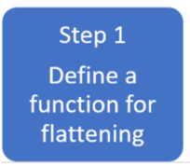
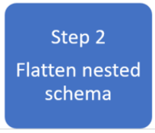
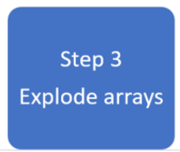
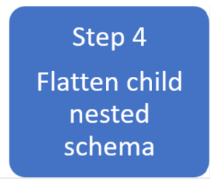

Analyze Complex Data types with Spark pools in Azure Synapse
Notes:
TALKING POINTS
Use Case
Complex data types are increasingly common and represent a challenge for data engineers as analyzing nested schema and arrays tend to include time-consuming and complex SQL queries.
It can be difficult to rename or cast the nested columns data type.
Performance issues arise when working with deeply nested objects. Data Engineers need to understand how to efficiently process complex data types and make them easily accessible to everyone. In the following example, Synapse Spark is used to read and transform objects into a flat structure through data frames.
Synapse SQL serverless is used to query such objects directly and return those results as a regular table.
With Synapse Spark, it's easy to transform nested structures into columns and array elements into multiple rows.
In the example the steps show the techniques involved to deal with complex data types.
Step 1: Define a function for flattening
We define a function to flatten the nested schema. This function can be used without change. Create a cell in a PySpark notebook with the following function in the screen.
Step 2: Flatten nested schema
Use the function to flatten the nested schema of the data frame (df) into a new data frame df_flat:
Step 3: Explode Arrays
Transform the array context_custom_dimensions in the data frame df_flat into a new DataFrame df_flat_explode. In the following code, we also define which column to select:
Step 4: Flatten child nested Schema
Use the function to flatten the nested schema of the data frame df_flat_explode into a new data frame df_flat_explode_flat:

Slide 13
Demo: Transforming data with Data Frames in Spark pools in Azure Synapse Analytics
Speaker name
Notes:
TALKING POINTS​
​
Let’s put this into reality and show you how it works.​
​
All instructions and context are found in this repository​
​
The demo instructions for this section can be found at: https://aka.ms/ctovtd32
​
The demo setup can be found at the following url: https://aka.ms/ctodesgdeployasyn​
​

Slide 14
Integrating SQL and Spark pools in Azure Synapse Analytics
Notes:
Talking Points:
What if you’d like to integrate SQL and Spark pools and use the benefits of both in Azure Synapse Analytics, How would you do that normally?
In the next slide you will be shown the Design of integrating Data transfer between Spark and SQL pools and the ease of use as well as the flexibility that comes with it.
You’ll also be shown an example of Writing a Spark Datafrom into a SQL Pool using the PySPark connector.
Resource:
https://github.com/solliancenet/azure-synapse-analytics-workshop-400/blob/master/day-01/lab01-data-integration-part-1.md#task-3-query-user-profile-json-data-with-azure-synapse-spark

Slide 15
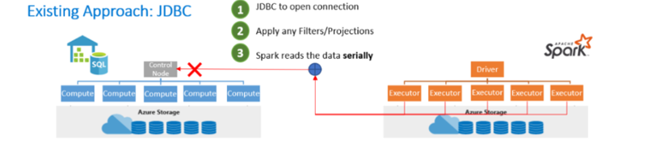
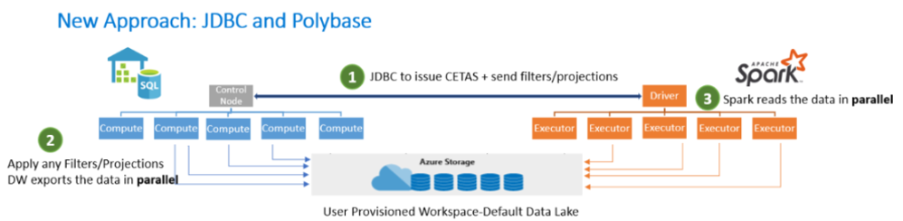
Design integrating Data Transfer between Spark and SQL pools
Notes:
Talking Points:
General info:
The Azure Synapse Apache Spark to Synapse SQL connector is designed to efficiently transfer data between Spark pools (preview) and SQL pools in Azure Synapse. The Azure Synapse Apache Spark to Synapse SQL connector works on SQL pools only, it doesn't work with SQL on-demand.
Design
The existing approach is Transferring data between Spark pools and SQL pools can be done using JDBC. However, given two distributed systems such as Spark and SQL pools, JDBC tends to be a bottleneck with serial data transfer.
The new approach:
The Azure Synapse Apache Spark pool to Synapse SQL connector is a data source implementation for Apache Spark. It uses the Azure Data Lake Storage Gen2 and Polybase in SQL pools to efficiently transfer data between the Spark cluster and the Synapse SQL instance.
It is also possible to write a Spark Dataframe into SQL Pool using a Pyspark Connector.
Assume you have a DataFrame "pyspark_df" that you want to write into the DW.
Step 1: Create a temp table using the DataFrame in PySpark:
Step 2: Run a Scala cell in the PySpark notebook using magics:
Similarly, in the read scenario, read the data using Scala and write it into a temp table, and use Spark SQL in PySpark to query the temp table into a DataFrame.
Extra information:
https://docs.microsoft.com/en-us/azure/synapse-analytics/spark/synapse-spark-sql-pool-import-export
Presenter Guidance:
Showcase the easy of use and flexibility of the notebook environment to switch between Spark pools and SQL pools for read/write.
More info can be found here: https://docs.microsoft.com/en-us/azure/synapse-analytics/spark/synapse-spark-sql-pool-import-export
Presenter notes and Guidance.
Use an example like * load CSV files from an ADLS Gen2 storage account in a Spark notebook, and write the data to a staging table in the SQL Pool
* Read back from the SQL table into a DataFrame. Load other flat files and join with SQL data for lookups

Slide 16
Demo: Integrating SQL and Spark pools in Azure Synapse Analytics
Speaker name
Notes:
TALKING POINTS​
​
Let’s put this into reality and show you how it works.​
​
All instructions and context are found in this repository​
​
The demo instructions for this section can be found at: https://aka.ms/ctovtd33
​
The demo setup can be found at the following url: https://aka.ms/ctodesgdeployasyn​

Slide 17
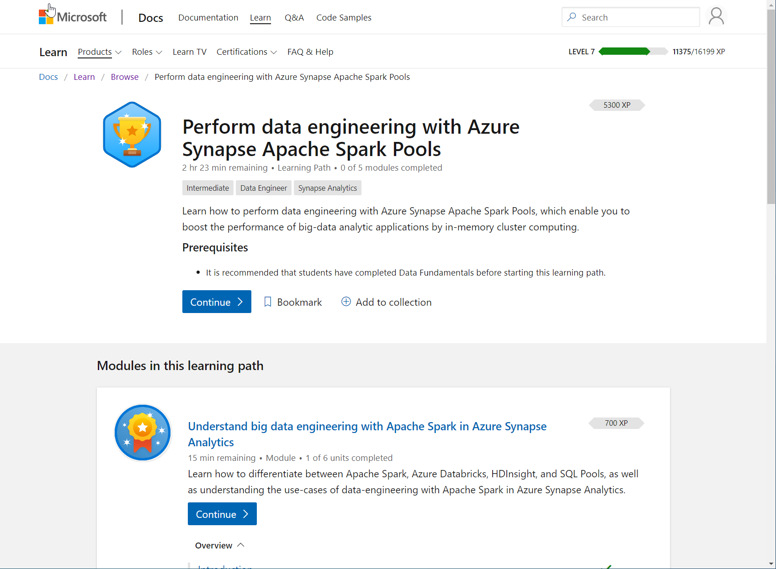
/learn alert
Complete interactive learning exercises, watch videos,
and practice and apply your new skills.
aka.ms/mslearnasaspark

